Slide 1
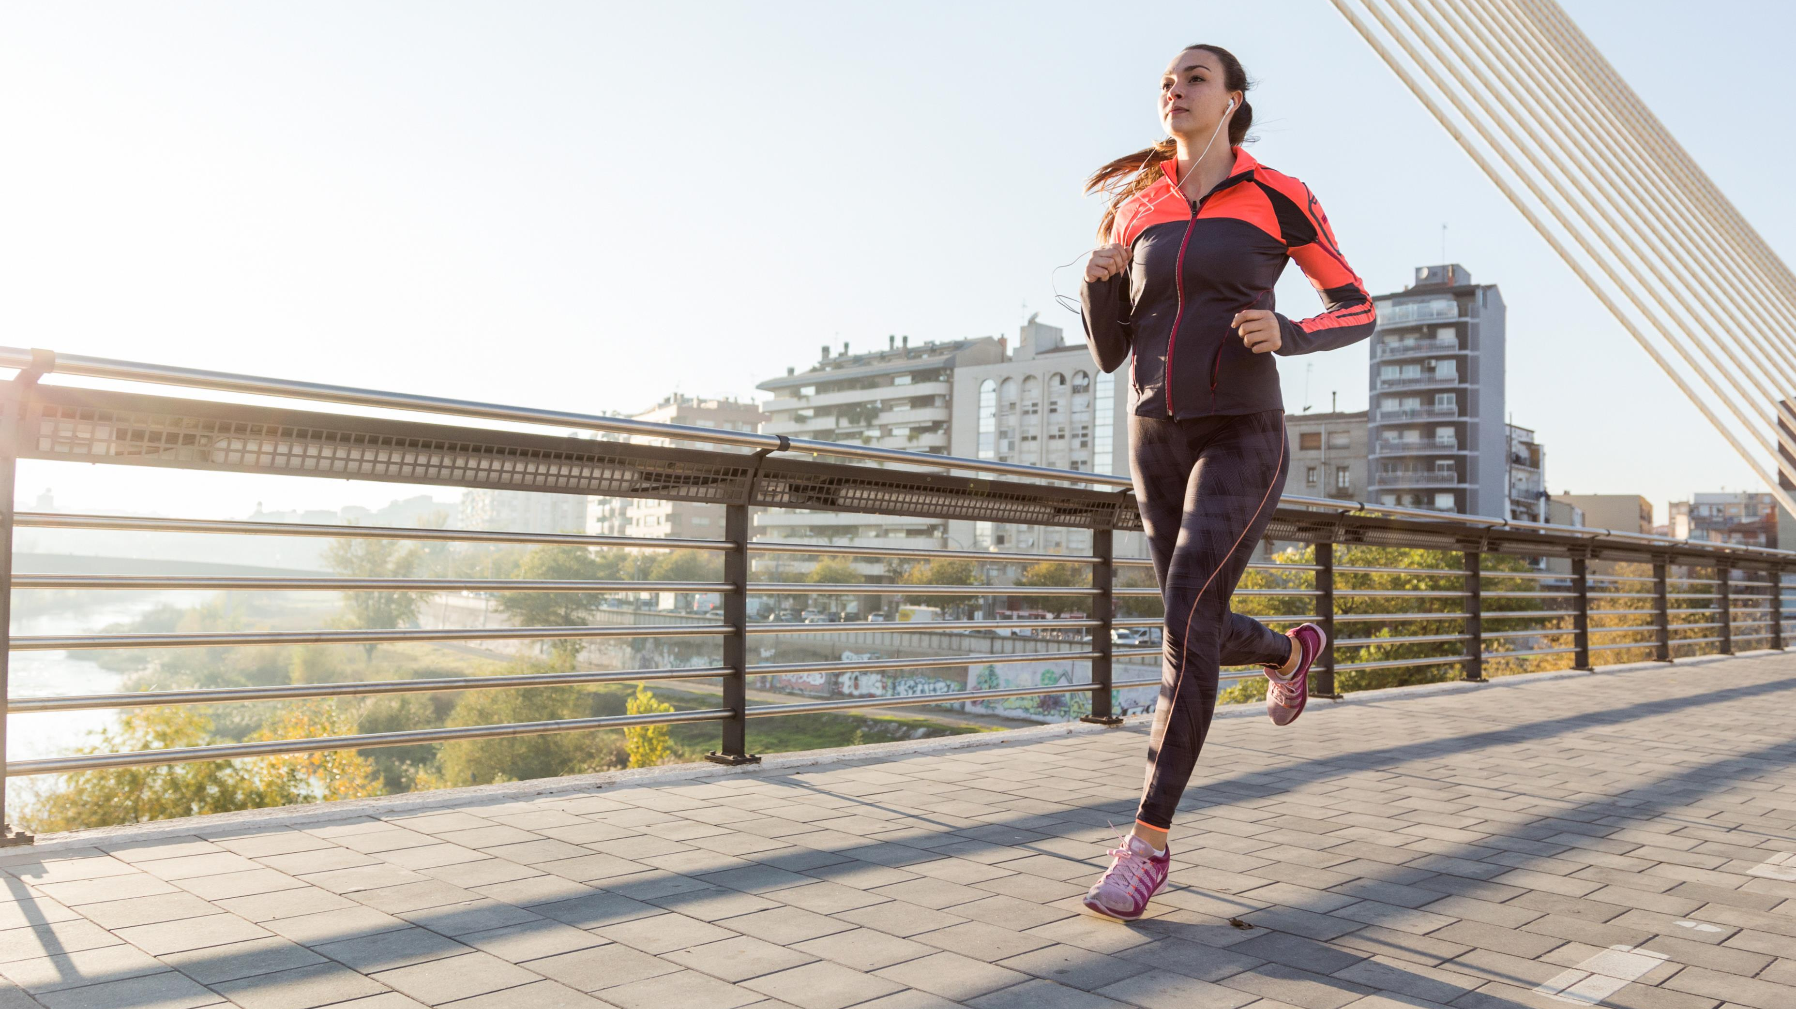

Sports Psychology:
beyond performance, acknowledging women in sports

Slide 2
WHY PSYCHOLOGY?
To understand how it
affect performance
To understand how
participation in sport
affects psychological
development, health,
and well-being

Slide 3
PSYCHOLOGY
DESCRIBE
EXPLAIN
Expected behaviors
Development
psychological
skills
Positively
affect
performance
PREDICT

Slide 4
CONCEPTUAL MODEL FOR INTEGRATING ATHLETES’ NEEDS & SPORTS DEMANDS
Athletes Needs:
Psychological
contributors
to performance
Sports demands:
Physical technical
logistical
Sports demands:
Psychological
Integration of athlete
Needs and sport
Demands
Development of
competitive mental
preparation strategies

Slide 5
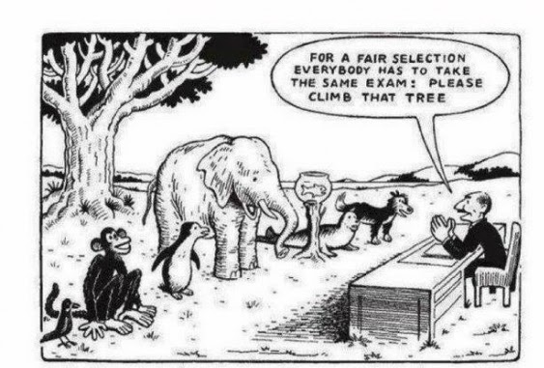
One size does not fit all
Notes:
Guidance notes:
We all know this intuitively… but it is normal and tempting to develop an approach and stick with it…
How many deliverers are armed with the skills and tools to be responsive to different people with different sets of needs?

Slide 6
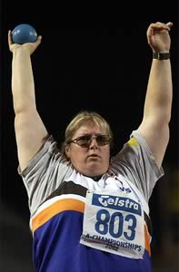
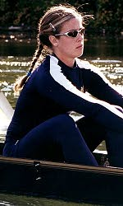
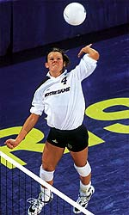
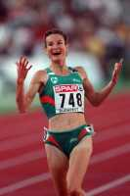
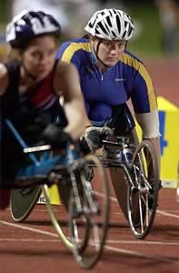
Female Athletes: All Shapes & Sizes
What do these women have in common?
They all participate in SPORT!

Slide 7
IN ORDER FOR SPORT TO ENGAGE WITH WOMEN IT MUST ALIGN ITSELF WITH THEIR VALUES
Notes:
Guidance notes:
In order for sport to engage women, it must align itself with their values
The fitness industry is currently very well positioned to the Looking Good and Feeling Good values – big marketing spend, high visibility and strategic communications from commercial providers
Sport is not very well positioned but we can align it much more effectively – we need to re-design and re-position sport and physical activity to the values and engage women and girls

Slide 8






A COMPLEX VALUE SYSTEM
LOOKING GOOD
FEELING GOOD
HAPPINESS
CONTENTMENT
SELF WORTH
NURTURING
MY FRIENDS
& FAMILY
ACHIEVING
MY GOALS
DEVELOPING
MY SKILLS
HAVING FUN
Notes:
Guidance notes:
Women hold six core values which inform their behaviour and decision making
The six core values that the research has identified as being those women prioritise in life are:
• looking good
• feeling good
• achieving goals
• developing skills
• nurturing friends and family
• having fun
They represent what is important to women in modern life and how they want to spend their time and energy. These values will be dialled up and down for different women and at different stages in their lives.
Feeling good is a growing priority for women. Women see the importance of looking after holistic mind, body and soul, as contributing to longer term health. They are increasingly investing in their emotional and spiritual wellbeing as well as physical. Wholesome experiences and ‘me-time’ are increasingly being prioritised as women seek to avoid letting stressful lives get the better of them.
“I feel fitter and stronger and happier and more comfortable in my body than ever, none of that is related to my dress size or goal weight but instead the strength I am building in my muscles.” (Linda)
Looking good is a value that resonates with many women, and increases in importance at different times in their lives. This can include being slim, toned, having muscle definition or taking care of hair and nails. The importance of this value is likely to increase when women are approaching ‘on show’ events like weddings, holidays and parties.
“All I’m thinking about is my body in a bikini on the beach.” (Poppy)
Nurturing friends and family: Women value spending time with family, friends, children and partners, often instinctively prioritising others’ needs over their own. Wives and mothers invest their time in their family’s development - particularly in the case of their own children. Women often adopt the role as family linchpin.
“My commitment is at home and my family are almost my team, I need to be there for them.” (Sam)
Achieving goals: Women like to feel as if they are progressing in life. They set themselves goals of what they’d like to achieve in life, not just professionally but also personally, and feel a great sense of satisfaction when they are able to tick these off. Women can be very determined in seeking to achieve these goals, especially when proving others wrong in terms of what they are capable of.
“It’s important for me to be ambitious and achieve things in life – I like to make sure I am getting the most out of life and making sure I tick all those things off my bucket list while I can!” (Anne)
Developing new skills to enhance personal development is an important element of life. Women want to feel as if they are learning new things, developing as a person and broadening their horizons. They can gain satisfaction from mastering something new, increasing their knowledge or producing something. There is also interest in developing soft skills such as leadership, interpersonal skills and coaching.
“I use the internet to research how to do things – it’s amazing what you can find online – there are really good tutorials that take you though it step by step.” (Maureen)
Having fun is a fundamentally important part of women’s lives. It provides an essential release from the day to day grind that women can often feel. Having fun is about doing things they choose to do rather than feel obligated to do. Socialising, interacting and laughing with friends is an essential part of life. However spending time alone can also fulfil this value.
“I don’t know what I’d do without my friends to have a laugh with at the end of a hard day!”

Slide 9
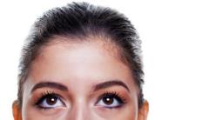
“I think about exercise everyday”. “I feel guilty about exercise everyday”
Women shoulder a lot of guilt which causes exercise to carry with it negative overtones
I should be healthier
I’d like to lose weight
I shouldn’t be so lazy
All my friends are exercising
I think I would feel better
I used to like it
Notes:
Guidance notes:
We also know that women and girls think about being active all the time - whether it's about being healthier or losing weight!
However, there is a lot of guilt out there. Just realising what you’re not doing or should be doing almost immediately make sport and exercise a negative thing.

Slide 10

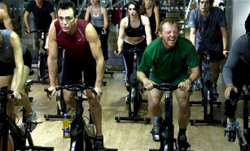
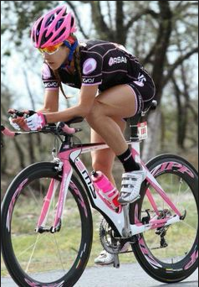
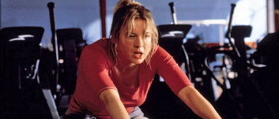
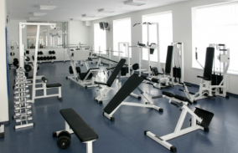
Emotional barriers are just as important as practical barriers
FEAR OF JUDGEMENT
Notes:
Guidance notes:
And our emotional barriers are often our primary barriers (before practical barriers are even considered).
Our pattern of thought, when it comes to considering something new, is never ‘what is the very best way that I could do this? what are my options?’ but rather ‘what is the very worst thing that could happen if I do this? And how can I be sure that won’t happen?’
This relates to Sport England’s insight into barriers to exercise for women – please read ‘Go Where Women Are’ on the Sport England website for full details
Fear of being judged is for many an important all-encompassing concern, which then surfaces re-articulated in the form of another more ‘acceptable’ barrier. For example, whilst a woman may cite lack of time as the reason she doesn’t manage to do any exercise, her concern could actually be that (in the case of mums in particular) spending time on exercise will be perceived as self-indulgent and implies she is neglecting other priorities such as spending time with her family.
Fear of being judged also includes:
A fear of being in unfamiliar territory, not knowing how to use any of the equipment and looking out of place.
A fear of being exposed for lacking ability, being the odd one out when the rest of the class are all really fit.
A fear of looking sweaty or un-attractive in an open or busy environment
A fear of looking like the odd one out by wearing the wrong thing or not having the right gear.

Slide 11
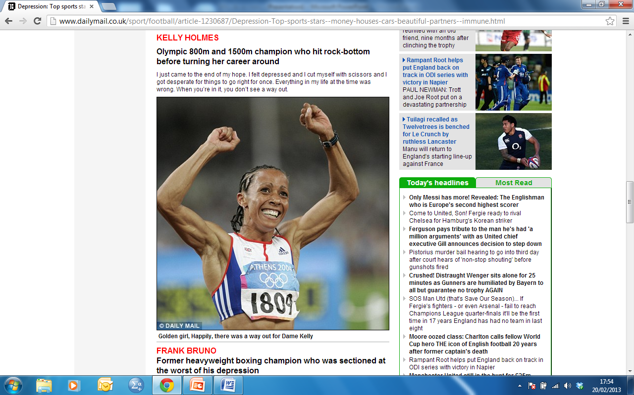

Slide 12
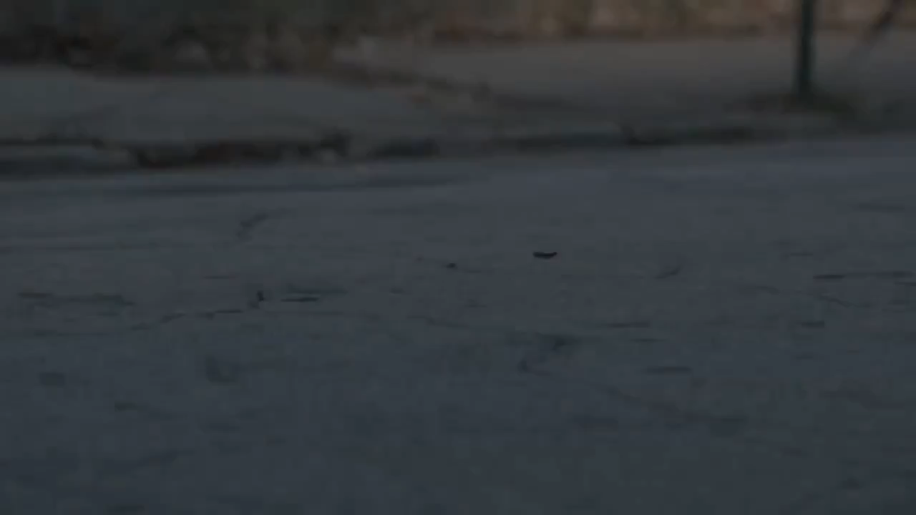

Slide 13
Women & Sports
Special Consideration (Menarche, Menstrual Dysfunction, Pregnancy, Menopause)
Female athlete Triad (Anaemia, Osteoporosis, and Amenorrhoea)
Psychological Aspects of Women
Sociological Aspects of Sports Participation
Ideology
Notes:
Menarche – it is the first menstrual period of a girl that generally happens at the age of 12-14
Menstrual Dysfunction - absence of menstrual period, abdominal cramps, irregular periods, delay in first menstrual period
Pregnancy- it is seen as break in sports career
Menopause- it is the permanent stoppage of primary functions of the ovaries

Slide 14
The Female Athlete Triad
Disordered Eating
Amenorrhoea
Osteoporosis
Notes:
Symptoms of triad may include fatigue, frequent injuries, loss of endurance, increased healing time of injuries, irritability
Anaemia – decrease in the amount of RBC or haemoglobin in the blood, iron deficiency, regular menstrual losses increase the iron need of female athletes, should take iron reach food
Osteoporosis- decreased bone material contents, bone fracture, low oestrogenl evel and calcium intake (insufficient calcium in diet)
Amenorrhoea – an absence of menstruation for three or more months (homornal changes, intensive exercise)

Slide 15
Women participation
Gender inequality is strongly evident in the field of sports
Less opportunities in comparison to their male counterparts
Social environment inhibits women from sports participation
More sports women emerging as role models

Slide 16
Reasons for less participation of women in sports
Lack of education and awareness
Traditional outlook and views
Male dominated culture of sports
Lack of female sports person as a role model
Lack of female coaches
Lack of personal safety
Lack of interest of spectators and less media coverage
Lack of access to sports facilities

Slide 17
Psychological Aspects of Women Participation
Gender Role Orientation
Competitiveness
Confidence
Self – Esteem
Self – Image
Depression
Aggression

Slide 18
Sociological Aspects of Women Participation in Sports
Family ( parent’s Interest, socializing at home)
School ( important place for sports participation, coaches, peers and teachers are the main driving force)
Culture ( great impact, traditional values)

Slide 19
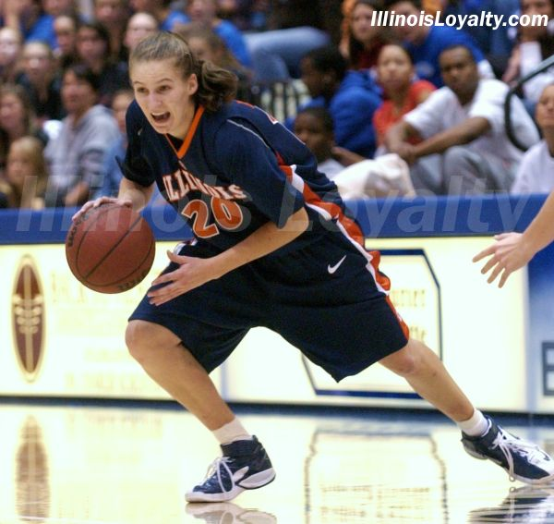
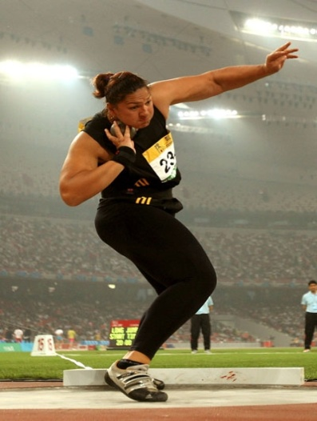
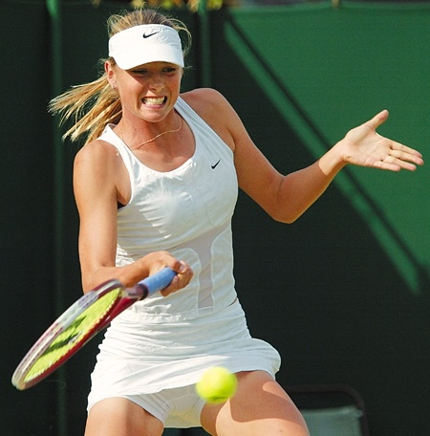
Physical Differences
Different doesn’t mean better or worse.
It just means different.

Slide 20
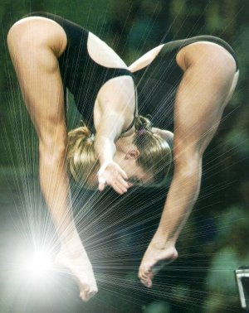
Cardiovascular Differences
Women have smaller heart, lungs, blood volume and haemoglobin concentration (10% lower) than men – this limits aerobic metabolism
Females have the same proportional capacity as males to improve their cardiovascular fitness
Female athletes burn more fat when exercising

Slide 21
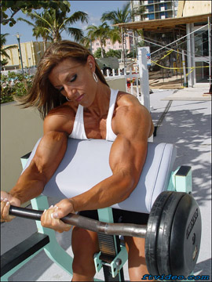
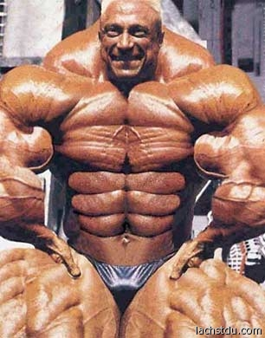
Strength Differences
Women tend to have less muscle mass due to lower levels of testosterone – this limits strength and power.
Upper body – 40/50% weaker than men.
Lower body – 30% weaker.
Females have the same proportional capacity as males to improve their strength levels through training.

Slide 22
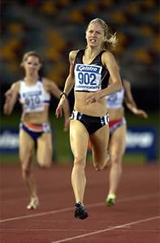
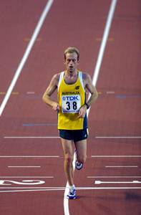
Body Composition
In general, female athletes (even lean ones!) have a higher proportion of body fat than male athletes.
Females – 20-25% body fat
Males – 15 – 20% body fat
Extra fat stores - good for swimming (buoyancy) and long endurance events

Slide 23
Exercise and the Menstrual Cycle
Olympic medals have been won at all stages of the cycle
Awareness of pre-menstrual symptoms
  Personal diary, look for patterns
Flexibility of training programmes
Regulation of the menstrual cycle and minimising symptoms

Slide 24
Exploding the Myths
Women can train as hard as men
Women can have the same % training improvement as men
The menstrual cycle does not limit a woman’s ability to train hard or to compete as hard as a man
Pain thresholds are not a male domain
Responsible authority under took the principle of equality of gender in its charter
All sports organizations encourage & promote the participation of women in sports & follow the
Principle of gender equality

Slide 25
MALAYSIAN SPORT CULTURE INDEX 2018

Slide 26
RESPONDENT PARTICIPATION IN SPORTS, EXERCISE OR
ACTIVE RECREATION BY AGE
RESPONDENT PARTICIPATION IN SPORTS, EXERCISES OR
ACTIVE RECREATION
GENDER | NOT INVOLVE IN SPORTS (%) | INVOLVE IN SPORTS (%)
Males | 26.7 | 73.3
Females | 32.2 | 67.8
n= 8,007 respondent
n= 8,007 respondent
GENDER |  | NOT INVOLVE IN SPORTS (%) | INVOLVE IN SPORTS (%)
Males | 13-19 years | 11.7 | 88.3
 | 20-29 years | 19.1 | 80.9
 | 30-39 years | 22.6 | 77.4
 | 40-59 years | 37.0 | 63.0
 | ≥ 60 years | 48.0 | 52.0
Females | 13-19 years | 13.3 | 86.7
 | 20-29 years | 23.7 | 76.3
 | 30-39 years | 31.8 | 68.2
 | 40-59 years | 41.1 | 58.9
 | ≥ 60 years | 56.9 | 43.1

Slide 27
RESPONDENT ACTIVENESS IN SPORTS, EXERCISES OR
ACTIVE RECREATION
RESPONDENT ACTIVENESS IN SPORTS, EXERCISES OR ACTIVE RECREATION BY AGE
n= 5,575 respondent
n= 5,575 respondent
GENDER | NOT ACTIVE (%) | MODERATELY ACTIVE (%) | ACTIVE (%) | VERY ACTIVE (%)
Males | 14.3 | 17.9 | 10.9 | 56.8
Females | 16.8 | 23.4 | 11.1 | 48.6
GENDER | AGE CATEGORY | NOT ACTIVE (%) | MODERATELY ACTIVE (%) | ACTIVE (%) | VERY ACTIVE (%)
Males | 13-19 years | 14.2 | 12.3 | 7.9 | 65.6
 | 20-29 years | 8.6 | 14.5 | 11.4 | 65.5
 | 30-39 years | 16.1 | 18.9 | 12.1 | 52.9
 | 40-59 years | 16.6 | 24.1 | 12.4 | 46.9
 | ≥ 60 years | 21.5 | 22.7 | 9.9 | 45.9
Females | 13-19 years | 14.1 | 19.3 | 8.5 | 58.2
 | 20-29 years | 15.1 | 22.5 | 10.9 | 51.6
 | 30-39 years | 17.9 | 28.6 | 12.2 | 41.3
 | 40-59 years | 19.0 | 22.6 | 12.4 | 46.0
 | ≥ 60 years | 21.6 | 26.8 | 12.6 | 38.9

Slide 28
TIME AND LOCATION FOR SPORTS ACTIVITIES
TIME
LOCATION
n= 3,692 respondent
n= 3,548 respondent
TIME | MALES (%) | FEMALES (%)
Morning | 16.8 | 23.0
Afternoon | 1.5 | 2.1
Evening | 56.2 | 57.1
Night | 25.4 | 17.7
LOCATION | MALES (%) | FEMALES (%)
1. Multi-purpose hall and public facilities | 36.3 | 32.1
2. Facility at the workplace | 3.2 | 4.7
3. Gymnasium | 5.5 | 4.8
4. Residential area | 14.7 | 14.9
5. Sports and recreation clubs | 4.6 | 4.1
6. Facilities at school/ institution of higher learning | 9.0 | 12.4
7. Facilities under the Ministry of Youth and Sports | 2.0 | 2.2
8. Sports complex | 8.5 | 8.2
9. Public field | 8.1 | 7.2
10. Water recreation centre | 1.0 | .6
Home | 3.6 | 5.0
12. Recreational park | 2.2 | 2.0
13. Other location | 1.3 | 1.7

Slide 29
TIME AND LOCATION FOR EXERCISE
TIME
LOCATION
n= 4,165 respondent
n= 4,112 respondent
LOCATION | MALES (%) | FEMALES (%)
1. Multi-purpose hall and public facilities | 16.3 | 15.9
2. Facility at the workplace | 3.8 | 4.5
3. Gymnasium | 15.8 | 9.8
4. Residential area | 20.0 | 22.9
5. Sports and recreation clubs | 3.0 | 3.4
6. Facilities at school/ institution of higher learning | 4.2 | 5.9
7. Facilities under the Ministry of Youth and Sports | 1.5 | 1.2
8. Sports complex | 5.3 | 4.2
9. Public field | 9.5 | 8.7
10. Water recreation centre | 6.7 | 9.5
Home | 12.6 | 13.2
12. Recreational park | 1.1 | .9
TIME | MALES (%) | FEMALES (%)
Morning | 34.8 | 41.2
Afternoon | 1.5 | 1.2
Evening | 50.1 | 45.9
Night | 13.5 | 11.6

Slide 30
TIME AND LOCATION FOR ACTIVE RECREATION
LOCATION
TIME
n= 1,775 respondent
n= 1690 respondent
LOCATION | MALES (%) | FEMALES (%)
1. Multi-purpose hall and public facilities | 12.4 | 12.9
2. Facility at the workplace
3. Gymnasium | 3.2 | 3.0
4. Residential area | 25.8 | 25.6
5. Sports and recreation clubs | 8.0 | 9.0
6. Facilities at school/ institution of higher learning | 2.8 | 2.6
7. Facilities under the Ministry of Youth and Sports | 2.6 | 1.9
8. Sports complex | 3.9 | 3.0
9. Public field | 7.6 | 7.4
10. Water recreation centre | 7.7 | 4.4
Home | 17.7 | 23.9
TIME | MALES (%) | FEMALES (%)
Morning | 42.1 | 46.6
Afternoon | 2.8 | 3.2
Evening | 46.1 | 45.2
Night | 9.0 | 5.0

Slide 31
MOTIVATING FACTORS FOR TAKING UP SPORTS, EXERCISES
OR ACTIVE RECREATION
n= 5,575 respondent
MOTIVATING FACTORS | MELES (%) | FEMALES (%)
1. Maintaining health | 90.0 | 88.9
2. Maintaining fitness | 88.6 | 86.5
3. Filling in spare time | 87.1 | 87.1
4. Spending time with friends | 86.9 | 84.1
5. Reducing stress | 85.4 | 85.5
6. Interest | 82.4 | 77.3
7. A way of life | 79.4 | 74.2
8. Spending time with family members | 77.9 | 80.1
9. Avoiding social ills | 75.8 | 73.0
10. Improving skills/performance | 75.0 | 66.5
11. Weight management | 70.7 | 74.3
12. Peer influence | 69.8 | 67.8
13. Personal appearance | 69.0 | 69.9
14. Social networking | 66.2 | 59.2
15. Involve with surrounding community | 65.4 | 61.9
16. Participating in sports/competitions | 56.8 | 48.2
17. Convalescence (medical doctor’s advice) | 55.8 | 55.8
18. Challenge the self in competitions | 53.2 | 45.1
19. Sports idol | 51.7 | 39.9
20. Looking for business opportunities | 42.7 | 35.1

Slide 32
BARRIERS FACTORS TO TAKING UP SPORTS, EXERCISES OR
ACTIVE RECREATION
n= 5,575 respondent
BARRIERS FACTORS | MALES (%) | FEMALES (%)
1. Weather | 53.9 | 55.5
2. Lack of free time | 52.1 | 55.6
3. Lack of sports facilities (basic) in residential/housing areas | 48.5 | 50.2
4. Laziness | 45.1 | 50.2
5. No Friends to do sport activities with | 44.6 | 53.2
6. Location of facility is too far away | 43.9 | 47.8
7. Lack of sporting equipment or facilities | 42.8 | 47.7
8. Schedule for sports facilities does not fit with my time | 42.7 | 45.4
9. Lack of information about existing sports facilities | 40.2 | 43.7
10. Lack of encouragement | 39.8 | 46.3
11. Not interested | 39.0 | 43.9
12. Health condition does not permit | 37.8 | 39.0
13. Lack of sports skills | 36.9 | 46.4
14. Fear of injury | 36.0 | 41.3
15. Too much bureaucracy to use sports facilities | 35.6 | 35.1
16. Sports equipment is too difficult to use | 35.1 | 37.2
17. Lack of transport service to sports venues | 34.1 | 40.2
19. Financial problems | 29.7 | 29.1
Shyness | 28.7 | 36.1
21. Violation of religious values and beliefs | 14.9 | 14.3

Slide 33
n= 215 respondents
Table 10: Type of Support Needed for Those Who are not Involved in Sport Activities, Exercise Activities, Active Recreation Activities and Mind Sports
No | Type of Supports | Frequency (n) | Percent (%)
1 | Time | 154 | 71.6
2 | Sport facilities | 105 | 48.8
3 | Environmental safety | 95 | 44.2
4 | Women coach | 92 | 42.8
5 | Child care centre in a sport facilities | 89 | 41.4
6 | Training | 79 | 36.7
7 | Support from family | 78 | 36.3
8 | Transportation | 70 | 32.6
9 | Sport equipments | 67 | 31.2
10 | Support from employer | 67 | 31.2
11 | Funds | 54 | 25.1
12 | Professional coaching | 32 | 14.9

Slide 34
n= 878 respondents
Table 11: Type of Support Needed
No | Type of Support | Frequency (n) | Percent (%)
1 | Time | 585 | 67
2 | Sport facilities | 495 | 56
3 | Environmental safety | 440 | 50
4 | Training | 433 | 49
5 | Women’s coach | 375 | 43
6 | Sport equipment | 374 | 43
7 | Support from family | 324 | 37
8 | Support from employer | 326 | 37
9 | Funds | 316 | 36
10 | Child care centre in a sport facilities | 300 | 34
11 | Transportation | 257 | 29
12 | Professional’s coach | 233 | 27

Slide 35
Table 12: Type of Activities
n= 878 respondents
No | Type of Activities | Frequency (n) | Percent (%)
1 | Jogging | 377 | 57%
2 | Aerobics | 217 | 33%
3 | Aerodance (Zumba, Poco-poco, etc) | 205 | 31%
4 | Badminton | 201 | 30%
5 | Hiking | 170 | 26%
6 | Netball | 157 | 24%
7 | Brisk walk | 145 | 22%
8 | Bowling | 140 | 21%
9 | Gym activities | 137 | 21%
10 | Cycling | 115 | 17%
11 | Athletic (marathon, triathlon, etc) | 102 | 15%
12 | Jungle Trekking | 102 | 15%
13 | Volleyball | 83 | 13%
14 | Futsal | 76 | 11%
15 | Aquatic (cth: swimming, etc) | 52 | 8%
16 | Martial arts | 48 | 7%
17 | Chess/ board games | 38 | 6%
18 | Yoga | 37 | 6%
19 | Traditional sports/ Rakyat (tarik tali, layang-layang, etc) | 36 | 5%
20 | e-Sport (Dota, PES etc) | 36 | 5%

Slide 36
Table 13: Perception Towards Women’s Participation in Sports
n= 878 respondents
No |  | Strongly Disagree |  | Strongly Agree
 |  | Frequency (n) | Percent (%) | Frequency (n) | Percent (%)
1 | Sports can improves fitness. | 8 | 1.0 | 870 | 99.0
2 | Sports causes my body odor. | 675 | 77.0 | 203 | 23.0
3 | Women’s suits involved in all kind of sports. | 266 | 30.0 | 612 | 70.0
4 | An appropriate sports wear influenced me to get involved in sports activities. | 98 | 11.0 | 780 | 89.0
5 | Sports eliminate the femininity characteristics. | 842 | 96.0 | 36 | 4.0
6 | Sporting/recreational monopolized by a particular gender. | 535 | 61.0 | 343 | 39.0
7 | Sports causes sunburn. | 574 | 65.0 | 304 | 35.0
8 | Sports involved high expenditure. | 529 | 60.0 | 349 | 40.0
9 | Sports can fill your leisure time | 27 | 3.0 | 851 | 97.0
10 | Existing facilities/infrastructure encouraged me to get involved in sport activities. | 310 | 35.0 | 568 | 65.0

Slide 37
Table 14: Respondent’s View to Increase Women’s Participation in Sports
No | List of Opinion
1 | Women’s coach
2 | Appropriate sports wear
3 | Isolation for sport venue
4 | Approriate and safe sport venue
5 | Completed sport facilities
6 | Child care facilities during sports
7 | Support from family
8 | The role of employer
9 | Awareness campaign
10 | Sport activities/ program specified only for women. Eg: Women’s Sport Day
11 | Time
12 | Gender descrimination

Slide 38


Institut Penyelidikan Pembangunan Belia Malaysia (IYRES)
Aras 10, Menara KBS, Presint 4,
No.27 Persiaran Perdana, Pusat Pentadbiran Kerajaan Persekutuan
62570 Putrajaya, Malaysia
Laman web
www.iyres.gov.my
Media Sosial
Facebook: kbs.iyres
Facebook:Enumerator community iyres
Instagram: iyreskbs

