Slide 1
Peranan dan Sumbangan Sektor Korporat dalam Agenda Pembangunan Belia di Malaysia
Junaidi Mansor
Pengarah
Pusat Belia Antarabangsa
14 Mac 2019

Slide 2
Belia dan Pekerjaan
…meneliti lanskap

Slide 3
Bilangan kekosongan jawatan berbanding output graduan, 2015-2018
Nota: Output graduan adalah berdasarkan maklumat oleh Kajian Pengesanan Graduan, 2015-2018
Sumber:
Laporan Penyiasatan Tenaga Buruh 2017, DOSM (2018)
Statistik Guna Tenaga Suku Tahunan, 2015-2018, DOSM (2019)
Graduate Tracer’s Study, KPM (n.d.), http://graduan.moe.gov.my/skpg-report/Dashboard/TrendKadarRespons.aspx

Slide 4
Statistik kekosongan jawatan mencatatkan penurunan daripada 236,000 (2015) kepada 198,000 (2018) (sektor formal swasta)
Sumber: Statistik Guna Tenaga Suku Tahunan, 2015-2018, DOSM (2019)
Notes:
7.1 Positions
Positions refer to the total labour that firm is willing to employ at any given point of time.
Positions is the sum of filled positions and vacancies.
7.2 Filled Positions
Filled positions refer to the persons employed at the end of every month in the reference
quarter.
Includes:
• Full-time and part-time employees;
• Permanent, short-term or seasonal employees;
• Employees paid with monthly salaries or based on hours worked;
• Employees on paid vacation or other paid leave; and
• Newly hired workers to fill the vacancy in the reference quarter.
Full-time employees:
Full-time employees refer to those who usually work for at least 6 hours a day
and/or 20 days a month.
Part-time employees:
Part-time employees refer to those who usually work for less than 6 hours a day and/
or less than 20 days a month.
Excludes:
• Individual proprietors and business partners;
• Unpaid family workers;
• Employees on strike during the reference quarter; and
• Employees on unpaid leave during the quarter of the reference period.
60 Statistik Guna Tenaga Suku Tahun Keempat 2018
Employment Statistics Fourth Quarter 2018
7.3 Vacancies
Vacancies refer to unfilled positions at the end of each reference quarter by category of
employment. A position is considered empty if it meets the following criteria:
• A specific position exists and ready to be filled. The position can be
full-time/part-time, permanent, short-term or seasonal;
• The job could start within 30 days, if qualified candidates are available
within the period; and
• Employers are actively seeking candidates including advertising vacancies,
issuing notices, informing public or private employment agencies, or trade
unions and/or will contact, or select the applicant who has applied
Excludes:
• Positions to be filled by existing employees due to internal transfers, promotions
or demotions, or recall from layoffs;
• Starting dates for the positions is more than 30 days;
• Hiring has been made to fill in the positions, but the employees have not reported
for work; and
• Positions to be filled by employees provided by other agencies such as
subcontractors and consultants.
7.4 Jobs Created
Jobs created refer to positions created in an organisation which were not
previously available, including newly created service schemes, positions
created for the promotion of existing employees and increase in the number
of positions from existing structure.

Slide 5
Sektor pembuatan mencatatkan kekosongan jawatan tertinggi sepanjang 2015-2018 (%)
Tahun | Sektor | Jawatan | Jawatan Diisi | Kekosongan | Pewujudan Jawatan
2018 | Pertanian | 5.6 | 5.5 | 13.1 | 9.1
 | Perlombongan & pengkuarian | 1.0 | 1.0 | 0.1 | 0.8
 | Pembuatan | 26.3 | 25.5 | 57.0 | 19.5
 | Pembinaan | 15.4 | 15.5 | 10.8 | 20.2
 | Perkhidmatan | 51.8 | 52.5 | 18.9 | 50.4
2017 | Pertanian | 5.7 | 5.5 | 14.7 | 8.8
 | Perlombongan & pengkuarian | 1.0 | 1.0 | 0.2 | 1.3
 | Pembuatan | 26.2 | 25.5 | 54.0 | 23.6
 | Pembinaan | 15.7 | 15.8 | 10.9 | 16.9
 | Perkhidmatan | 51.4 | 52.2 | 20.2 | 49.4
2016 | Pertanian | 5.6 | 5.4 | 14.4 | 8.1
 | Perlombongan & pengkuarian | 1.0 | 1.0 | 0.2 | 0.4
 | Pembuatan | 26.2 | 25.6 | 47.7 | 25.0
 | Pembinaan | 15.7 | 15.6 | 15.1 | 20.9
 | Perkhidmatan | 51.5 | 52.4 | 22.6 | 45.6
2015 | Pertanian | 5.7 | 5.4 | 15.3 | 10.5
 | Perlombongan & pengkuarian | 1.0 | 1.0 | 0.1 | 0.5
 | Pembuatan | 26.3 | 25.7 | 48.1 | 22.6
 | Pembinaan | 15.5 | 15.6 | 11.5 | 17.1
 | Perkhidmatan | 51.5 | 52.3 | 25.0 | 49.3
Sumber: Statistik Guna Tenaga Suku Tahunan, 2015-2018, DOSM (2019)

Slide 6
Pewujudan jawatan mengikut aktiviti ekonomi, 2015-2018
Sumber: Statistik Guna Tenaga Suku Tahunan, 2015-2018, DOSM (2019)

Slide 7
Sumbangan pihak korporat kepada pembangunan belia
…secara langsung dan tidak langsung

Slide 8
Sumbangan sektor korporat melalui skim latihan graduan…
Graduate Trainee Programmes
Khazanah Graduate Trainee Programmes
BAT Global Graduate Programme
Global Maybank Apprentice Programme (GMAP)
CIMB Complete Banker (TCB) Programme
Axiata Graduate Programme (AGP)
Notes:
Link to Survey Monkey

Slide 9
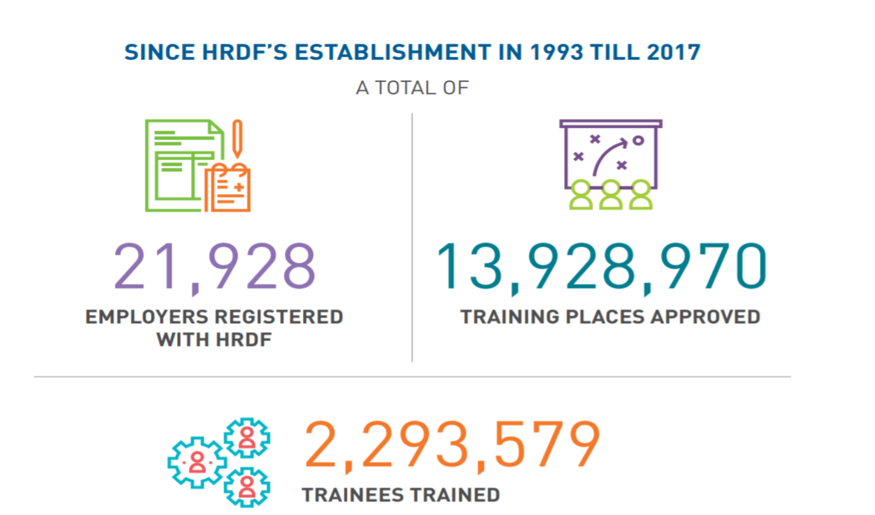
Sumbangan firma…
Pembangunan Sumber Manusia Berhad (HRDF) – 1% of salary contribution to fund. Collection for 2017 was at RM726m…
Notes:
Link to Survey Monkey

Slide 10
SL1M & GEMS
…melaksanakan inisiatif Kerajaan

Slide 11
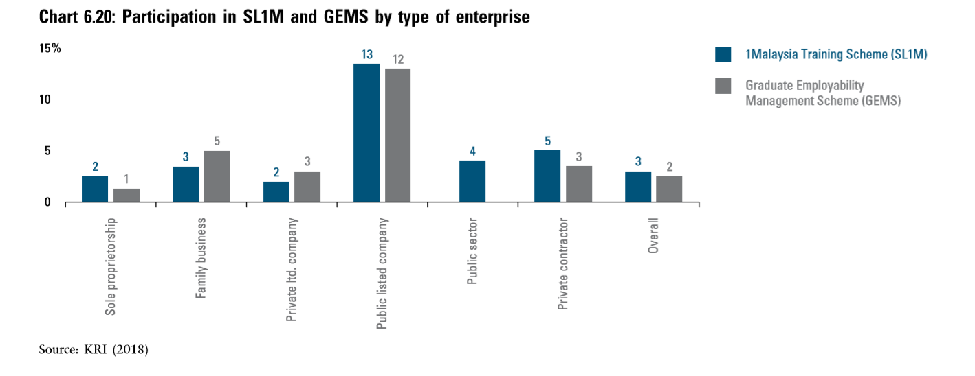
Penglibatan sektor swasta dalam SL1M dan GEMS…

Slide 12
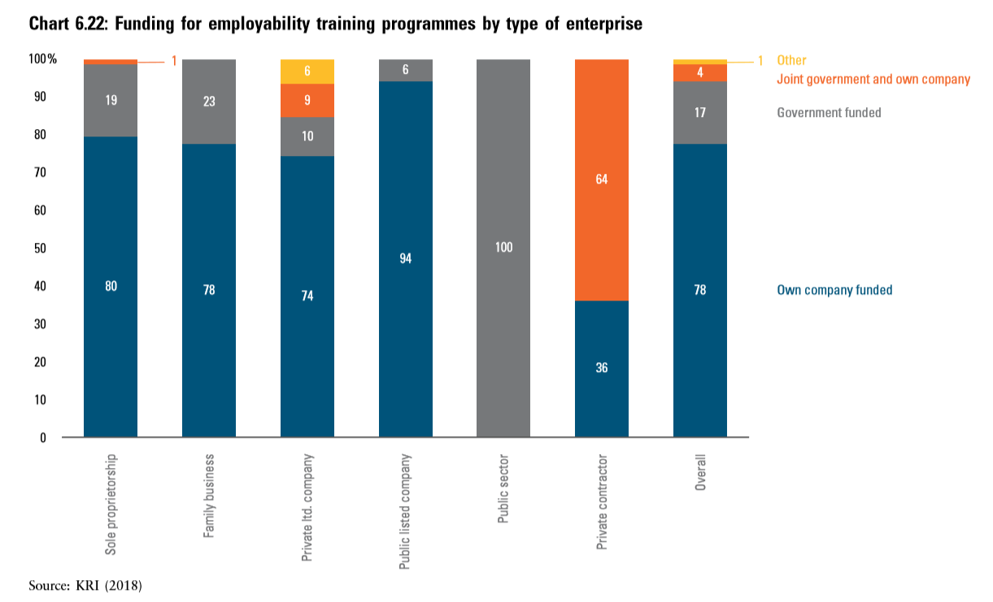
Dana program pembangunan masih dari sumber dalaman

Slide 13
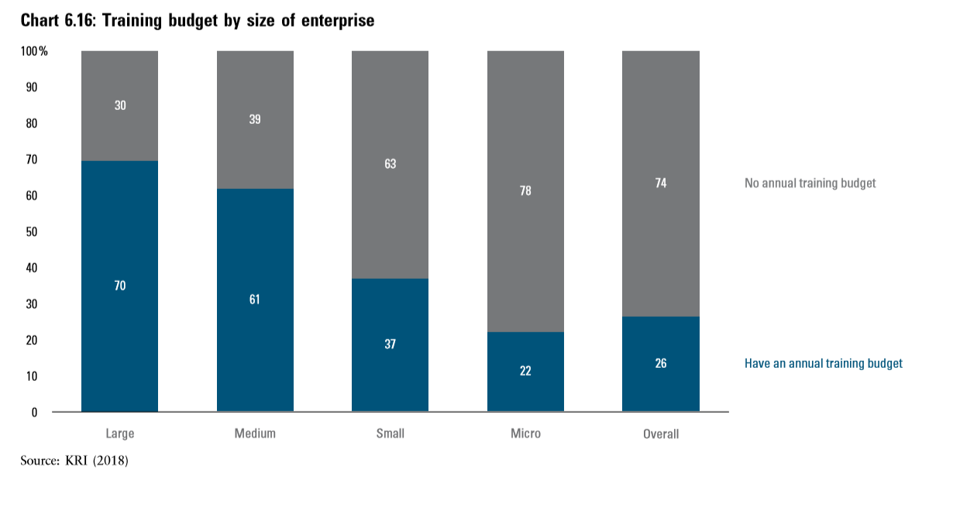
Hampir 2/3 syarikat menyatakan bahawa mereka tidak memperuntukkan dana untuk latihan…

Slide 14
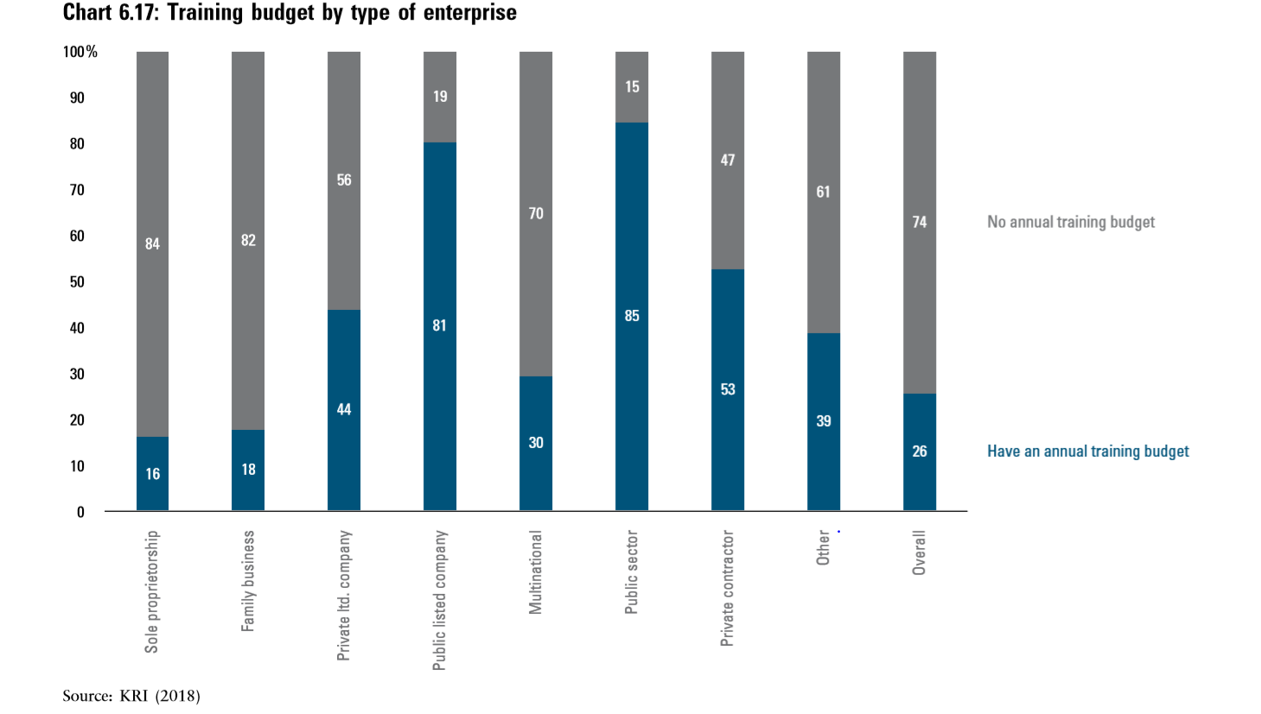
Kurangnya peruntukan untuk latihan….

Slide 15
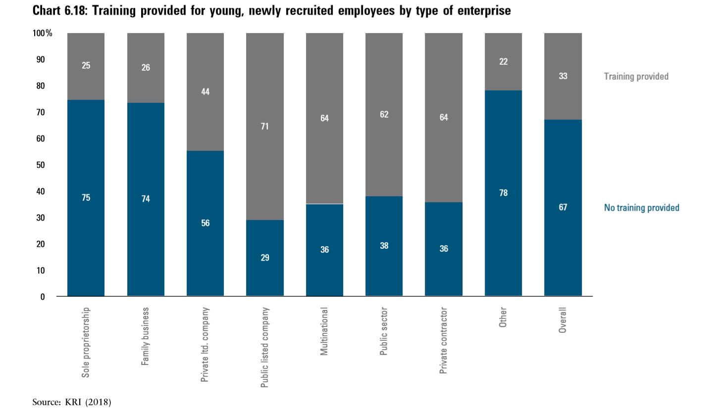
Kurang latihan permulaan, yang baru bekerja…….

Slide 16
pengalihan permintaan dan penawaran tenaga buruh
…memperluaskan peranan sektor korporat

Slide 17
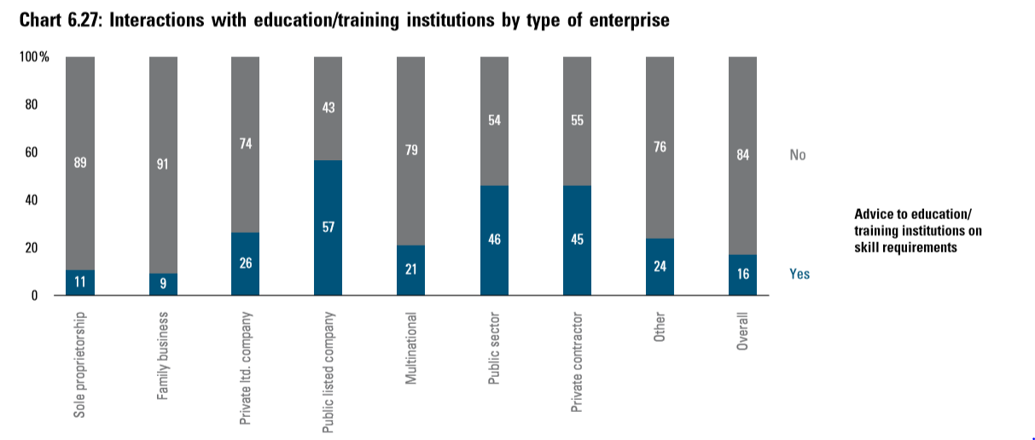
Kurangnya penyertaan sector korporat secara menyeluruh dalam mempertingkatkan tahap kemahiran

Slide 18
Belia berdaya saing
…realiti berbeda?

Slide 19
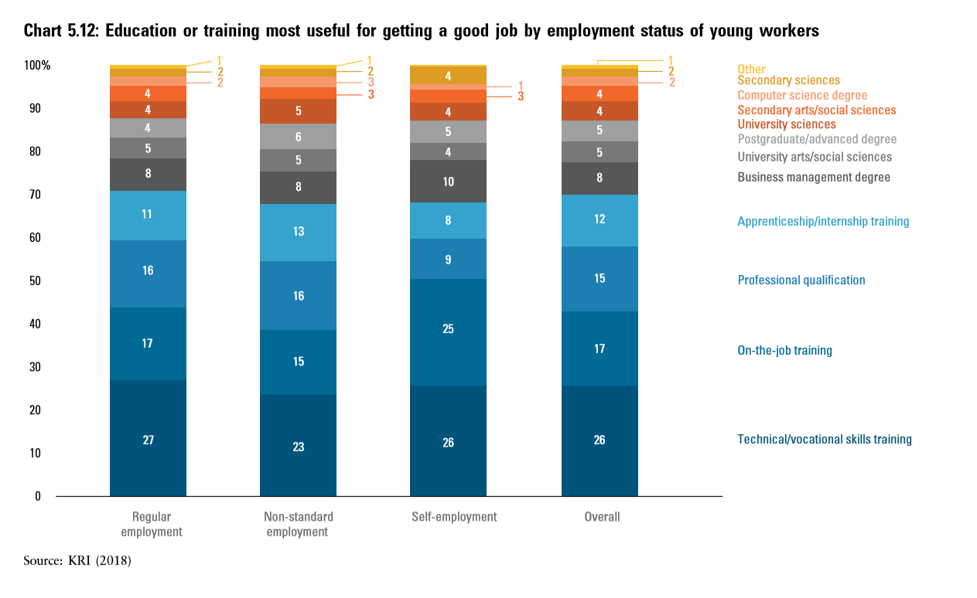
Belia masih melihat latihan dalam pekerjaan sebagai kriteria penting dalam mendapat pekerjaan…

Slide 20
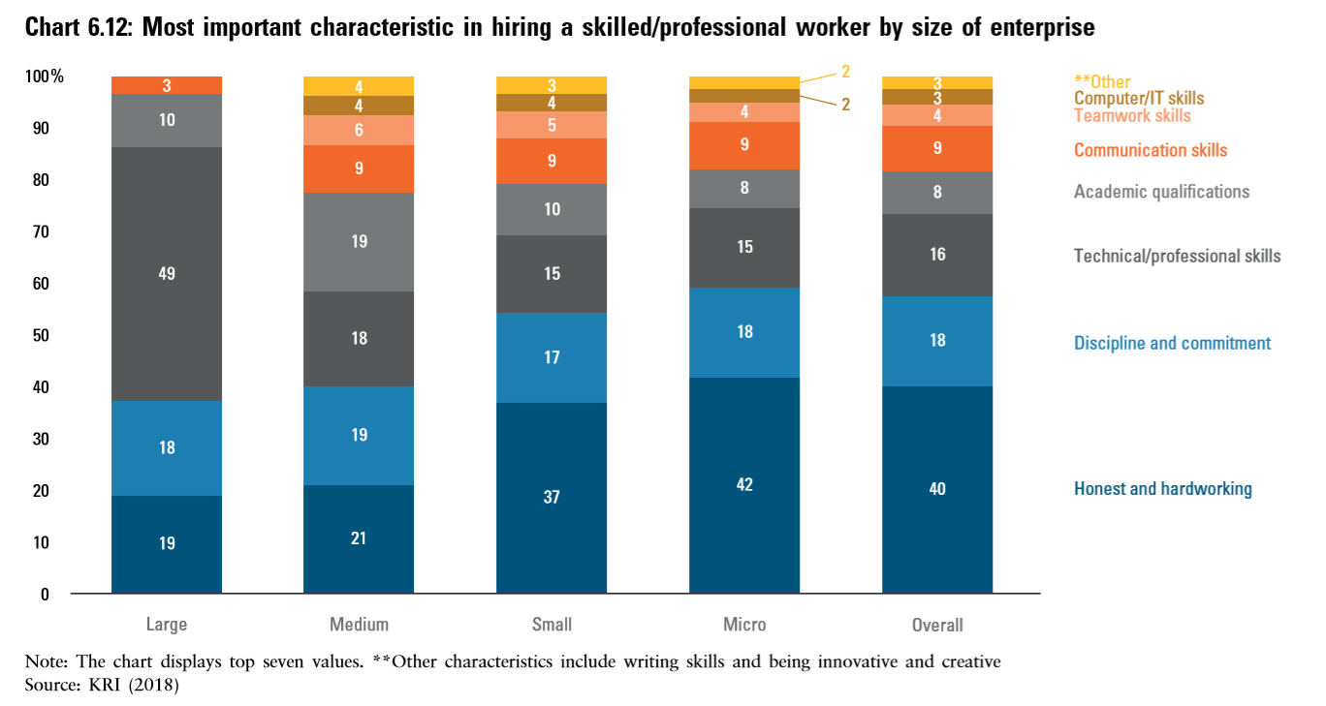
Sikap/ciri pekerja yang dimahukan

Slide 21
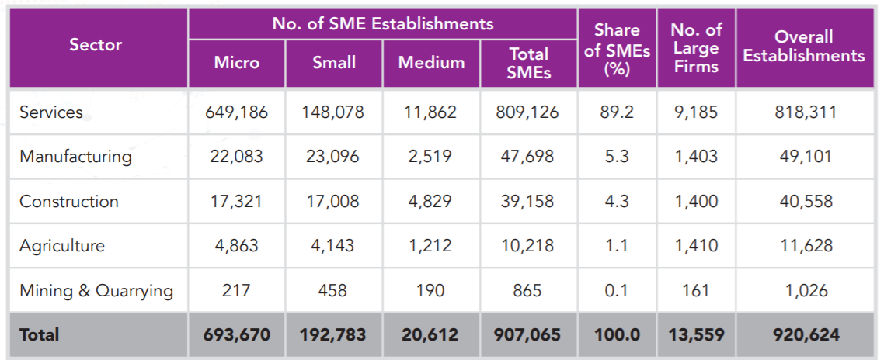
Belia lebih berminat untuk bekerja sendiri…

Slide 22
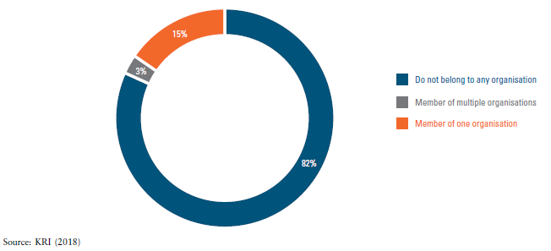
Belia sedang bekerja tidak aktif dalam berorganisasi

Slide 23
Mencari halatuju…
Masa dan pengalaman – peluang sedia wujud untuk menerajui sektor korporat – risiko kepada umum dan pihak berkepentingan sebagai pengukur.
Millennials – perubahan aspirasi serta sikap memerlukan ekosistem yang berbeza – “be your own corporate leader” dalam era keusahawanan.
Berdaya saing dalam dunia yang kompetitif – “terbaik” mungkin tidak mencukupi – “finding the 1%”.
Mencari suara belia – mencipta platform dan identiti.

Slide 24
Mempertingkatkan kemahiran belia
…usaha bersama

Slide 25
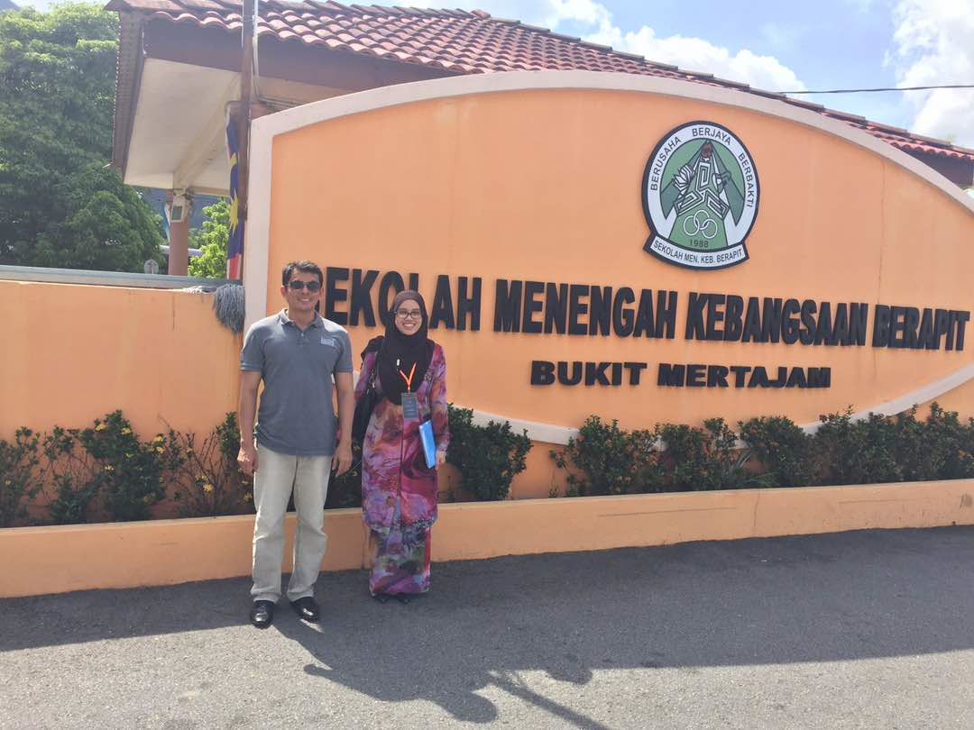
Perlunya interaksi bersama……
Belia
Firma
Kerajaan
“…dasar jangka panjang dan strategic, dalam keadaan demografik Malaysia…”
“…persekitaran yang kompetitif, belia perlu up the ante…”
“…wujudkan platform untuk bersuara yang bersifat neutral dan fokus kepada ekonomi…”
“…perlunya penglibatan firma pada semua tahap…”

Slide 26
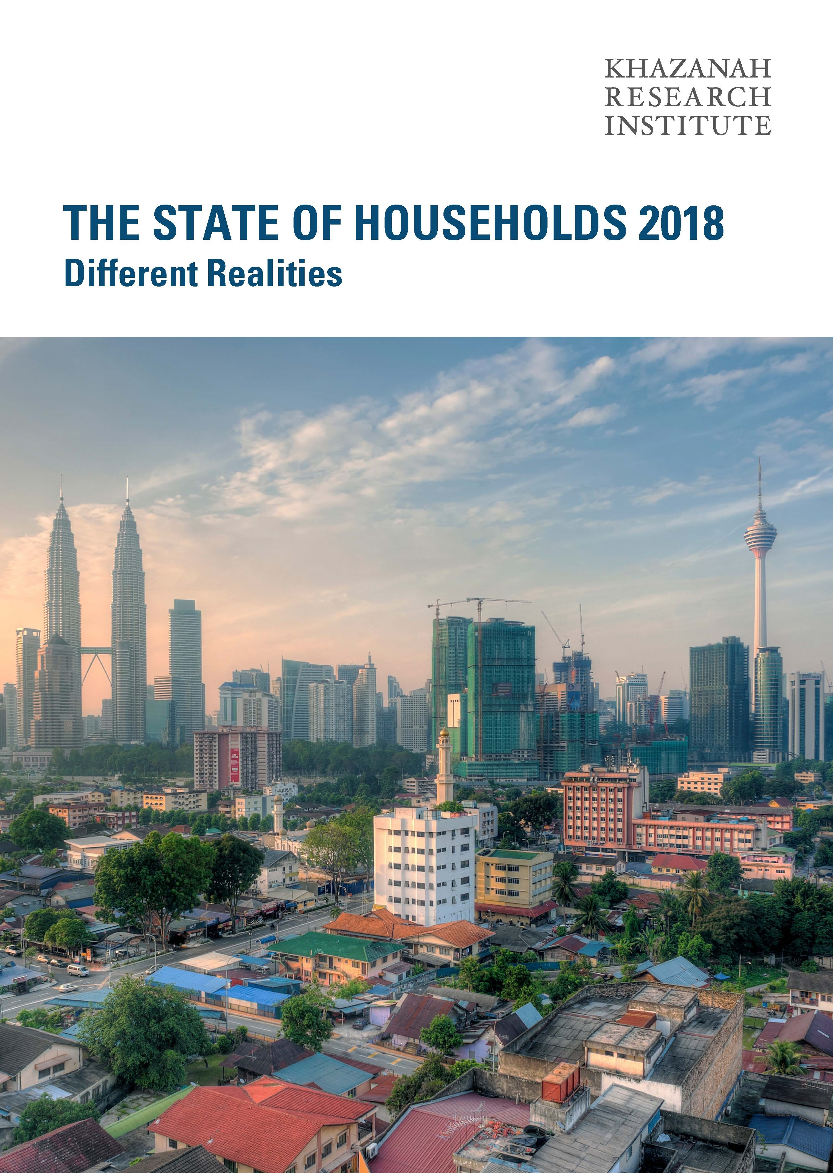
Further details:
http://www.krinstitute.org/Publications-@-The_School-To-Work_Transition_of_Young_Malaysians.aspx
http://www.krinstitute.org/Publications-@-The_State_of_Households_2018_-_Different_Realities.aspx

